Slide 1
Fundamentals and Methods of Computer Science
Exercise week 1

Slide 2
Today’s Menu
Getting you a working Python / Jupyter Notebook environment
Summary of Lecture content
Enable you to find, download, (unzip), and load Jupyter Notebooks
Short summary of Coding Python in 7 Slides

Slide 3
Python/Jupyter Notebooks

Slide 4
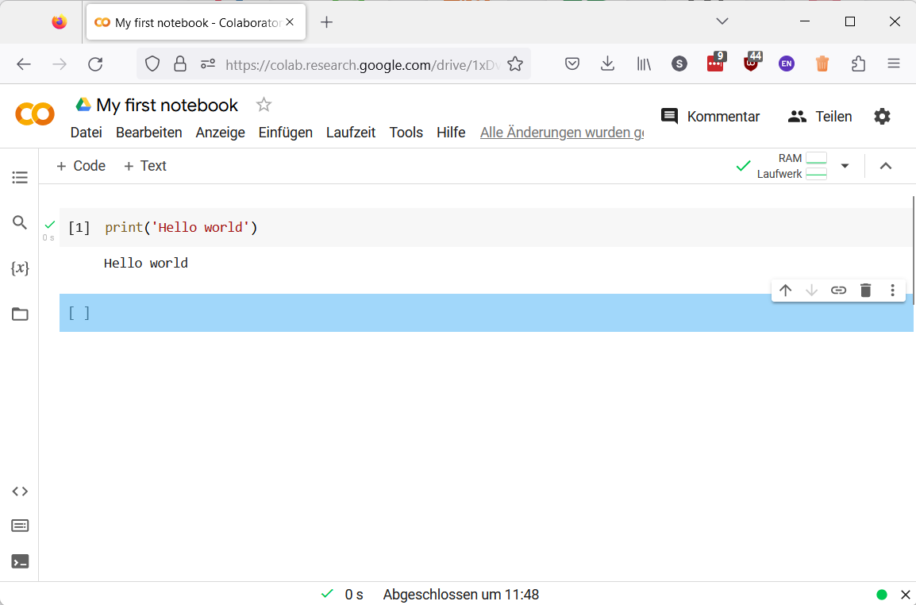
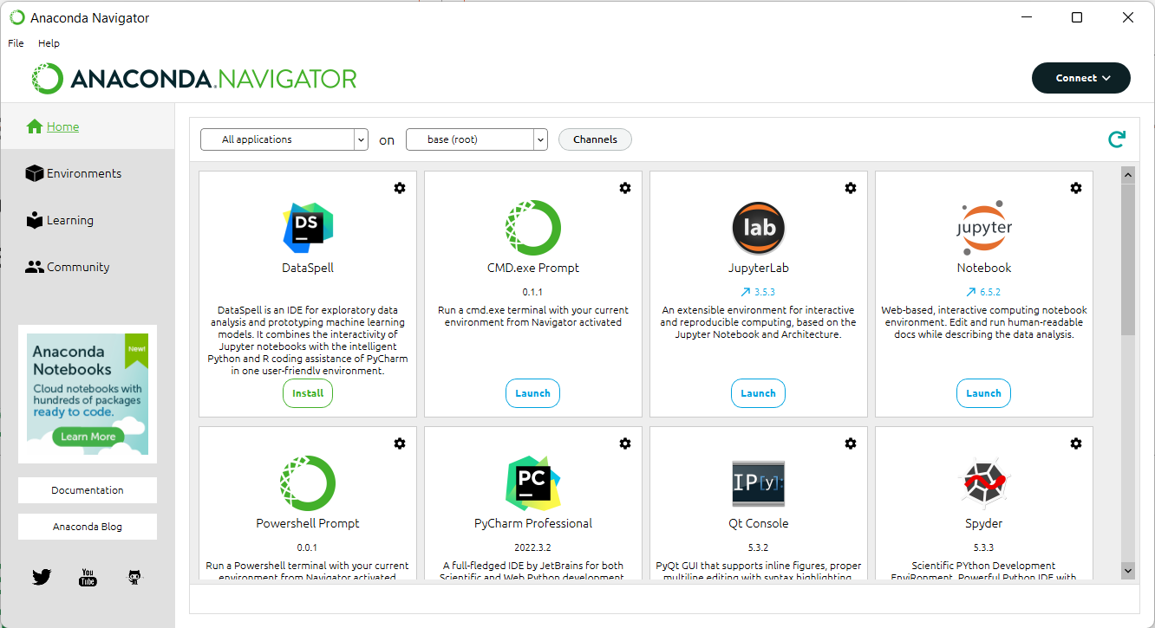
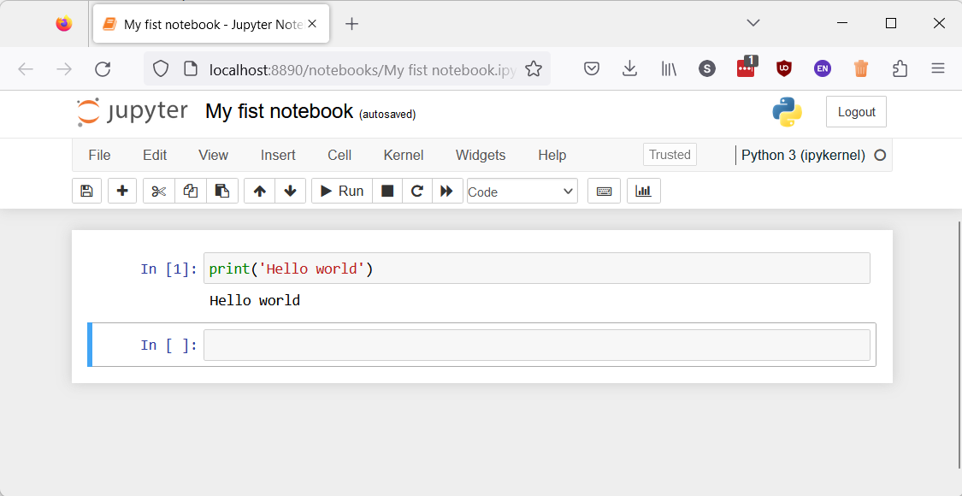
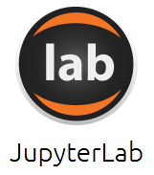

On your machine or in the cloud
While there are many more options, we support two ways of running Python/Jupyter Notebooks
On your machine: Anaconda
In the cloud: Google Colab
Anaconda is an easy to install and easy to use Python distribution that comes with everything we need.
Download https://www.anaconda.com/products/distribution
Install
https://web.microsoftstream.com/video/50227410-18db-452c-ae1a-6949b27bcfe1
Run
You typically need a Google account
Find https://colab.research.google.com/
Upload your notebook
Run

Slide 5

Python / Jupyter Notebook
Having a running Python and Jupyter Notebook available is crucial, because …
All the assignments will need such an environment
All the lectures will provide their contents via notebooks
Let’s do it … now
If there is one thing you should have by today it is a running Python / Jupyter Notebook.

Slide 6
Summary of Lecture Content

Slide 7
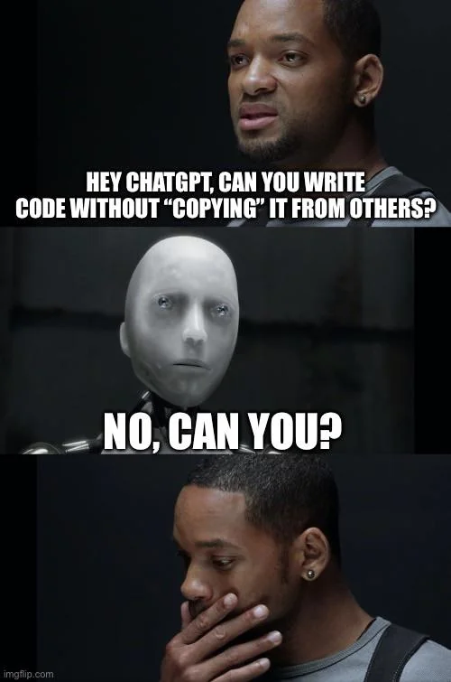

What is…?
Computer Science
Science of the efficient automation of processes
Programming
Splitting big tasks in smaller tasks that our computer can handle.
Using a certain language that the computer understands to give instructions.
Reuse. Reuse. Reuse.

Slide 8

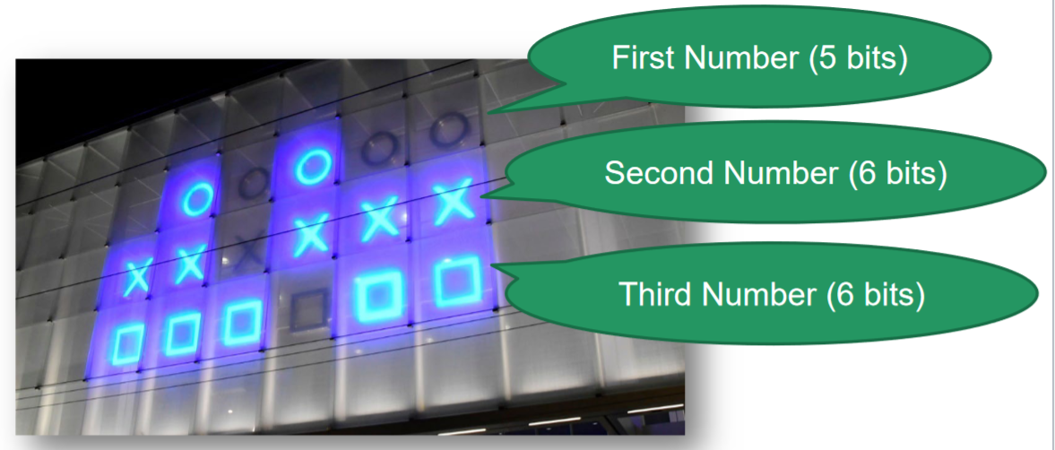
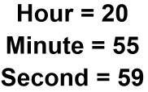
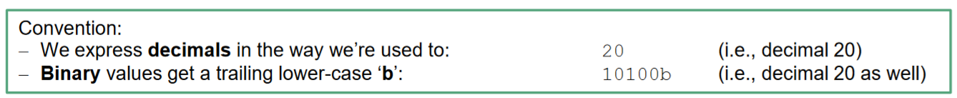

Bits (Binary Digits) & Bytes
Information = Bits (0/1; logical values True/false) + Context (Encoding)
Data in Bytes (usually 8 bits) → numbers 0-255($2^{n}−1$) [2^8 numbers]
Check your understanding by thinking about a hexadecimal clock - convention: leading ‘0x’

Slide 9
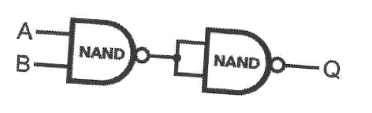
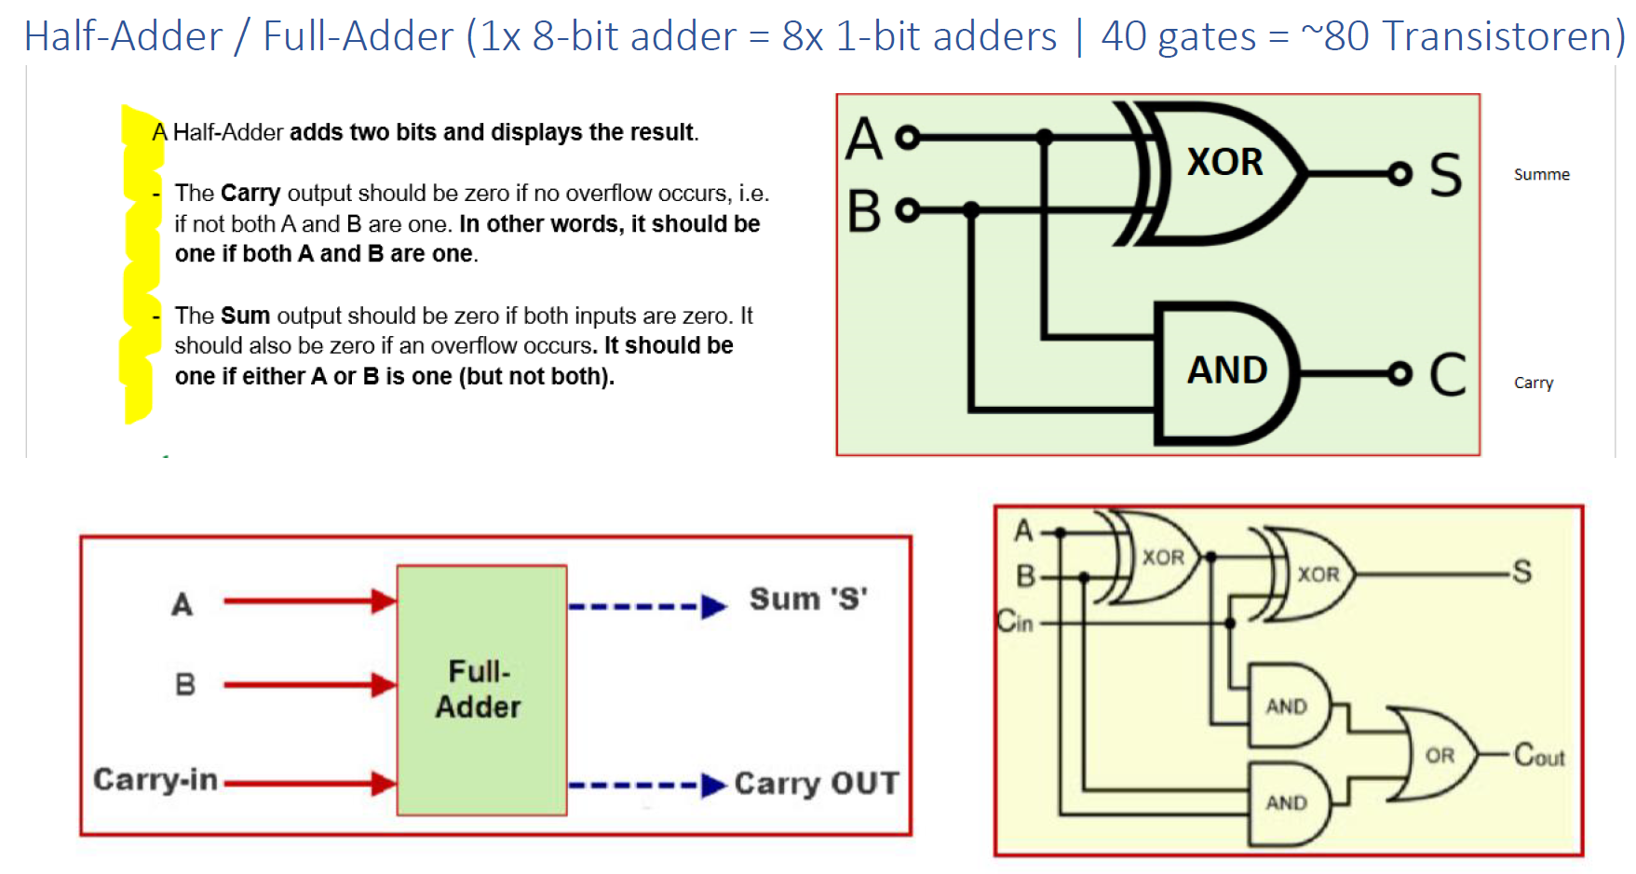
Boolean Algebra & NAND Gates
Boolean Algebra:
E.g. X=True=1, y=False=0
NOT ~x = 0;
AND (x & y) = 0;
OR (x | y) = 1;
XOR (x ^ y) = 1;
Transistors (electronical switches used today) can represent 0 & 1 (True & False) → in combination we can build all logical symbols
Functional Completeness of NAND:
NOT: A NAND A
AND: (A NAND B) NAND (A NAND B)
OR: (A NAND A) NAND (B NAND B)
XOR: (A NAND (A NAND B)) NAND (B NAND (A NAND B))
NOR: NOT(A OR B)
XNOR: NOT(A XOR B)
Half-adder & Full-adder

Slide 10
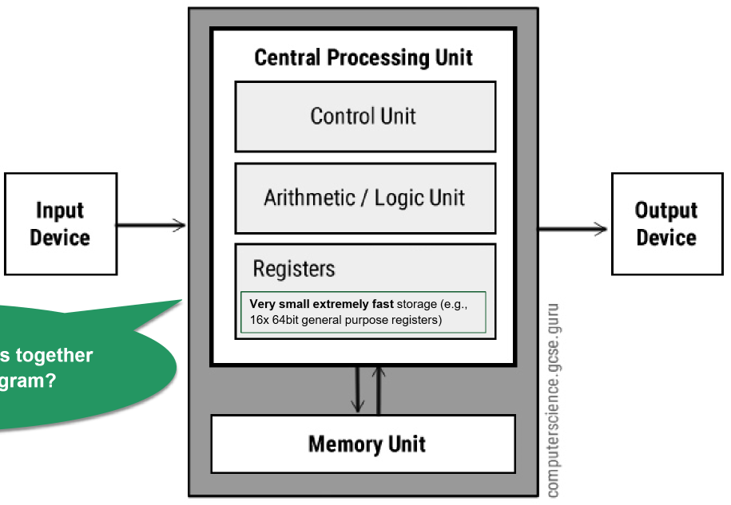
Arithmetic/Logic Unit (ALU) & Central Processing Unit (CPU)
CPU runs in a loop. In each cycle the CPU uses instructions to load data in the registers and computes the result to store in the memory unit.
Adding, Multiplier, Substractor & Divisor Circuits (4 Units) +
Memory for Input/Output +
Function select bits
Everything is a binary string interpreted as executable instructions.

Slide 11
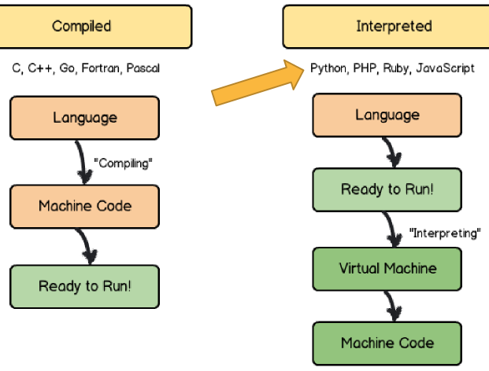
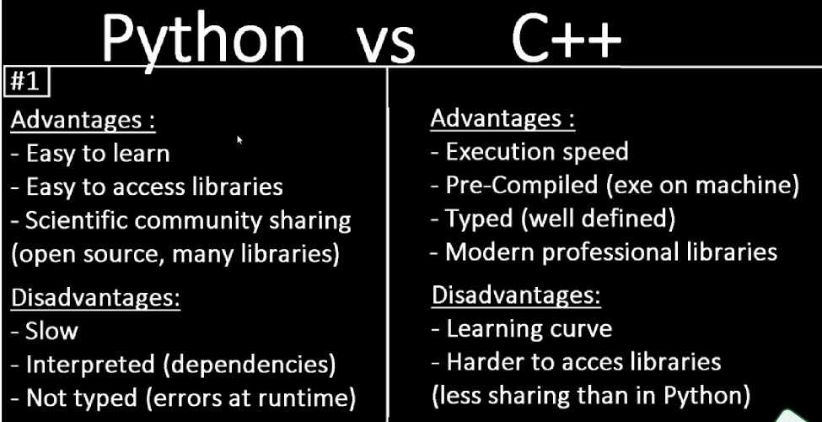
Compiled vs Interpreted Programming Languages
Compiled languages translate & validate the program before running, while interpreted languages are directly ready.

Slide 12
Let’s find, download, (unzip), and load Jupyter Notebooks

Slide 13
Introduction to Python:
1.1 – 1.4 (incl. excursus user input)
1.7
To read up

Slide 14
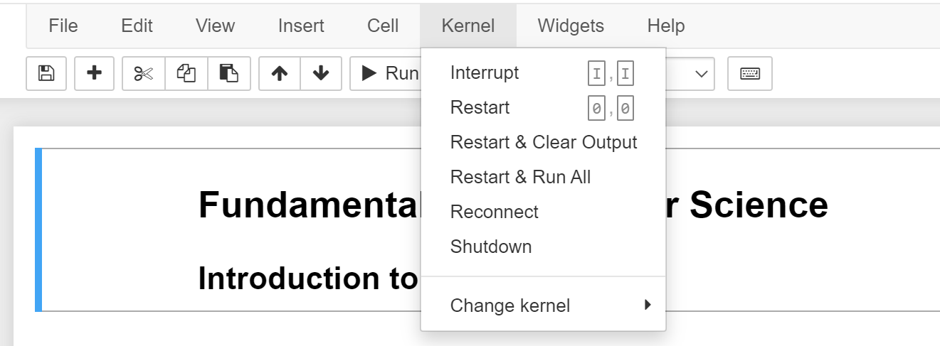
Troubleshooting in Jupyter
If your Jupyter Notebook:
does not run anymore, or
is taking more than a few (reasonable) seconds
Restart the Kernel!

Slide 15
Exercise 1:
Let’s solve the exercise together…
…to enable you to solve the assignment on your own!

Slide 16
Short “summary” of Coding Python in 7 Slides
This week we have some (very) quick start to be able to write some first program – in the next weeks we will take more time to properly introduce and extend some this week’s concepts.

Slide 17
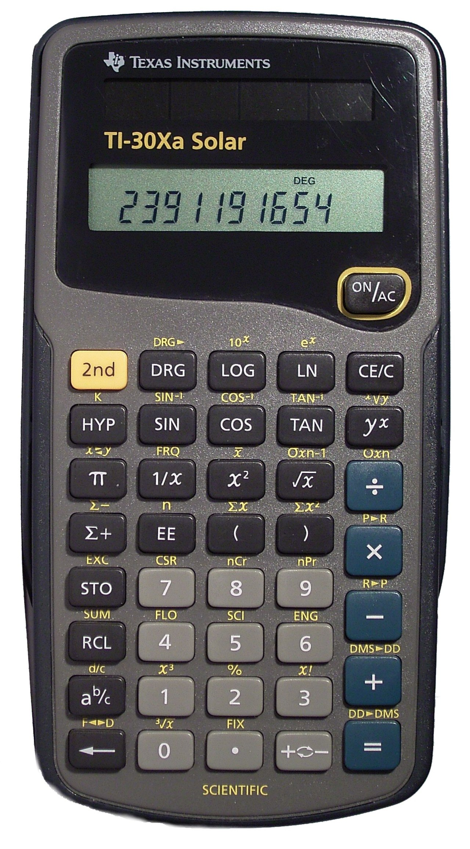
Introduction
A Simple Calculator as your first computer program!
You will learn how to assign values to variables and to do basic calculations
There are among others the following arithmetic operations in Python:
Addition: +
Subtraction: -
Multiplication: *
Division: /
Power Function: **
Example: 3**2 = 9 same as 3^2 (often written like that in Excel)
Modulo Function: %
In computing, the modulo operation returns the remainder of a division, after one number is divided by another (called the modulus of the operation)
Example: 17 % 5 = 2 (15/5 = 3 → the remainder up to 17 is 2)
So, Modulo does integer divisions and returns the remainder

Slide 18
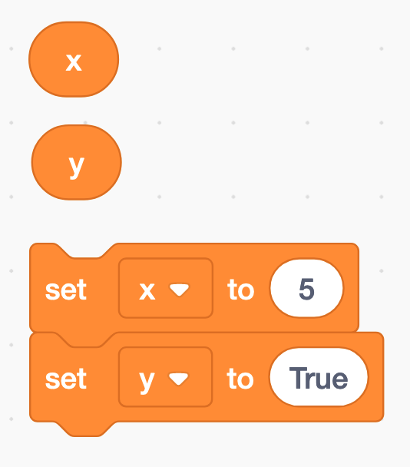
Assigning a value to a variable
The equal sign (=) is used to assign values to variables
x = 5
y = True
etc.

Slide 19
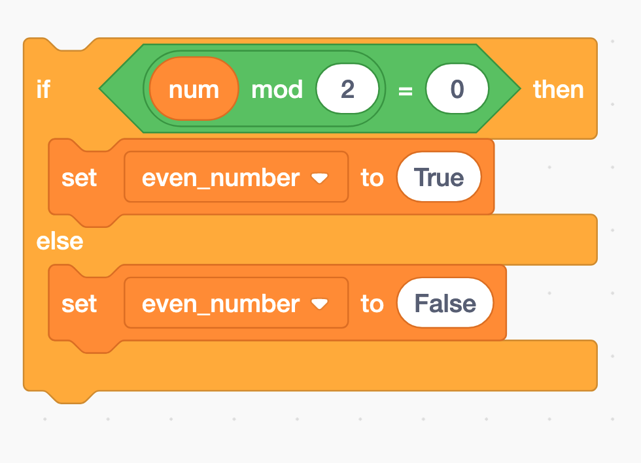
Modulo and if-statements (1) → next week
if num % 2 == 0:
even_number = True
else:
even_number = False

Slide 20
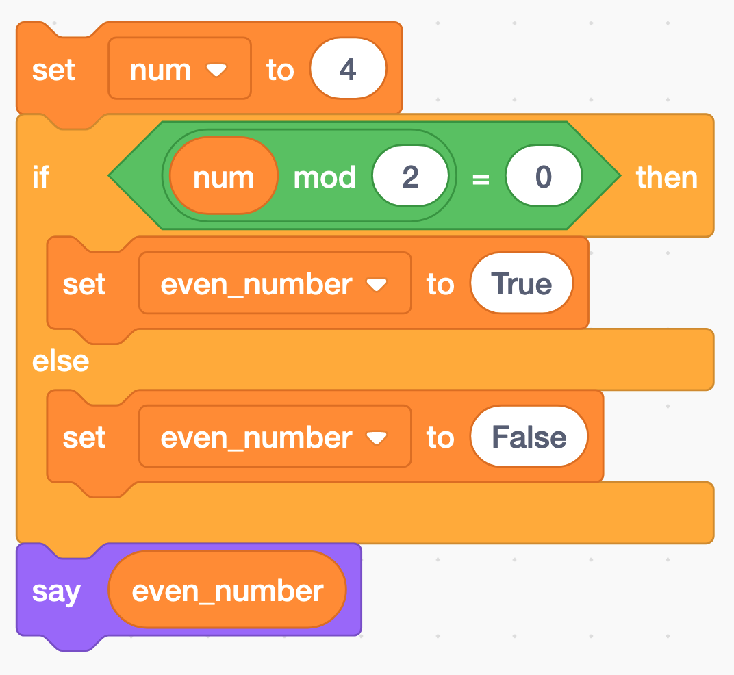
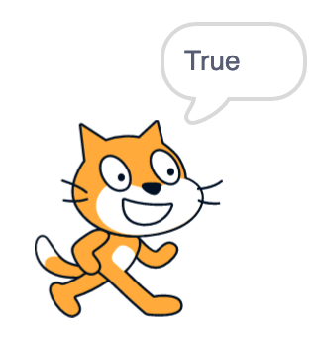
Modulo and if-statements (2) → next week
num = 4
if num % 2 == 0:
even_number = True
else:
even_number = False
print(even_number)

Slide 21
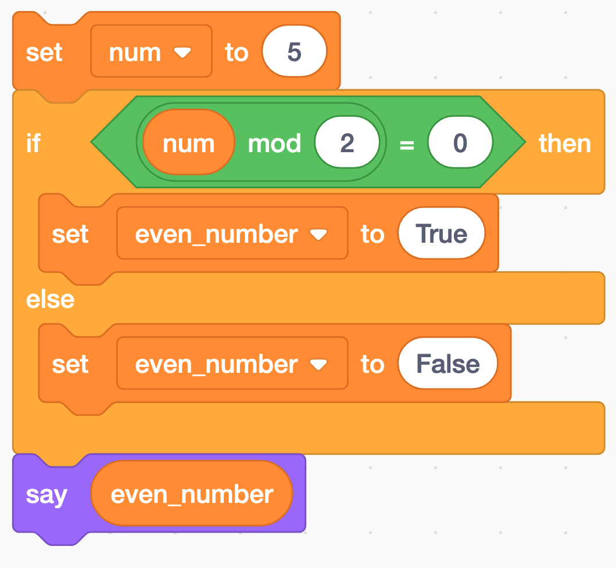
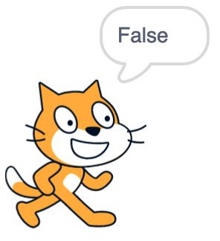
Modulo and if-statements (3) → next week
num = 5
if num % 2 == 0:
even_number = True
else:
even_number = False
print(even_number)

Slide 22
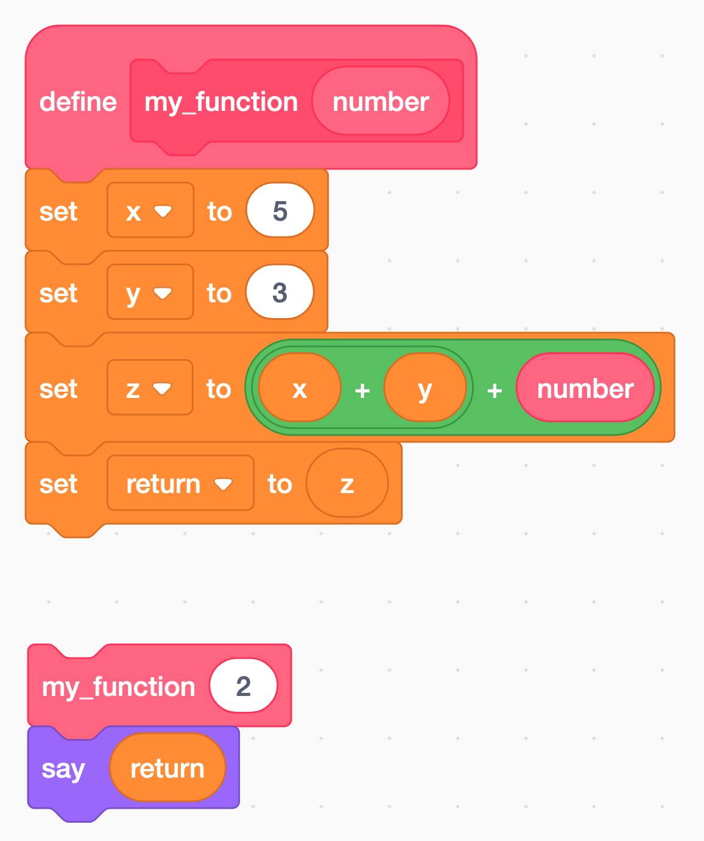
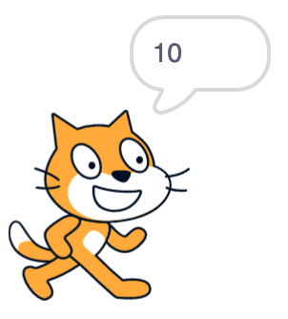
Functions → next weeks
A function is a block of code that only runs when it is called by its function name
You can pass data, known as parameters, into a function.
A function can return data as a result.
def my_function(number):
x = 5
y = 3
z = x + y + number
return z
print(my_function(2)) # this is the function call

Slide 23
Python data types → next weeks
Python has five standard data types:
Numbers
Sequences (Strings, Lists, Tuples)
Dictionaries
Sets
Boolean
Python sets the variable type based on the value that is assigned to it. Unlike more other languages, python will change the variable type if the variable value is set to another value. For example:
var = 123 # this will create a variable with type integer
var = ‘john’ # the “var” variable has now as type string
type(var) # returns the data type of the “var” variable
var_2 = ‘5’
var_2 = int(var_2) # changes the string variable var_2 to an integer variable (if possible)
int | a = 10 | Integer (whole number)
float | a = 45.67 | (.) Floating point real values
Numbers

Slide 24
Helpful web pages
https://stackoverflow.com/
https://www.w3schools.com/python/
https://www.programiz.com/python-programming
https://www.google.ch/?hl=de

Slide 25
Dominik Buchegger
dominik.buchegger@student.unisg.ch

